Slide 1
Badminton database
Name: renhui zhou
Student number:12454892

Slide 2
Background
This database is established which based on the real life that how badminton clubs work.
This database built the entity relationship diagram(ERD) to show the relationships between different entities.
The ERD also shows the attributes of every entities to demonstrate.
In this database, there are eight entities in the database. For example,
Coach, matches, members etc

Slide 3
Members
Member_payment
Badminton_club
Member_id
Club_id*
Member_type
Member_fees
Member_name
Gender
Member_phone
Member_email
Member_address
Payment_id
Member_id*
Club_id*
payment_method
Paid_time
Club_Id
Club_Name
Year_established
Club_contactnum
Club_address
has
has
Matche_place
Match_Place_id
Address_name
has
go
join
Coach
Coach_Schedule
Match_participation
Club_id*
Coach_id
Gender
Name
Coach_qualification
Coach_phone Coach_manager*
Coach_manager_club*
has
Coach_id*
Coach_Club*
Member_id*
Member_club*
Session
Period
Match_id*
Member_id*
Member_club*
has
Matches
has
Match_id
Match_time
Adress_id*
Match_type

Slide 4
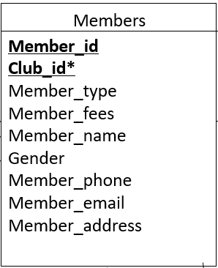
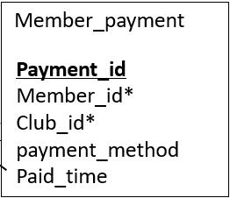
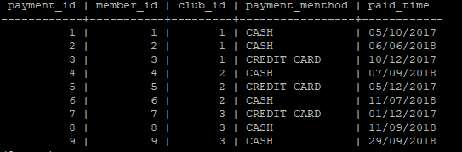
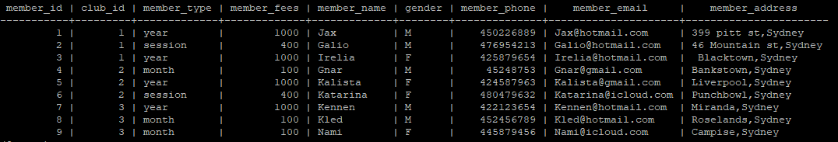
One to many relationship
has
Foreign key

Slide 5
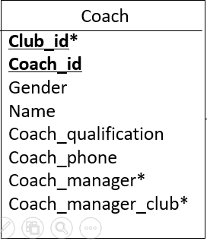
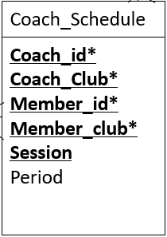

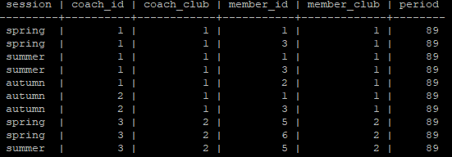
Many to Many relationship
go
The table coach_schedule

Slide 6
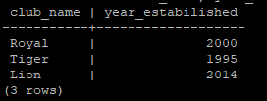
Query
1. A simple query of a single table.
Actual query
select club_name, year_estabilished from badminton_club;
//This query is going to find the club name and the established year of all clubs with a single table.
Output

Slide 7
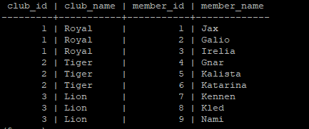
2. A query which uses the words "natural join".
The actual query
// This query is going to find the club_id, club_name, member_id, member_name from two tables which are badminton_club and member
select club_id,club_name,member_id,member_name from
badminton_club natural join member;
The output

Slide 8
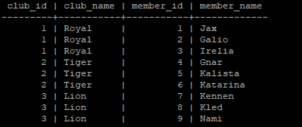
3. The cross product equivalent to the "natural join" query.
//this query use the cross product to find the data from two tables which are member and badmin_club when they have the same club_id;
The actual query
select bad.club_id,bad.club_name,mem.member_id,
mem.member_name from badminton_club bad,
member mem where bad.club_id =mem.club_id;
The output

Slide 9

4.A query involving a “Group by”, perhaps also with a “HAVING”.
// this query is going to count the member number of the club which id =1 and the result has been categorized in one group
The actual query
select club_id,club_name, count(member)
from badminton_club natural join member where club_id = 1
group by club_id, club_name;
The output

Slide 10

5.query which uses a sub query
//this query is going to found the the member who give the minium money of all members in different clubs.
The actual query
select member_id,member_name,club_id,member_fees from member
where member_fees <= all(select member_fees from member);
The output

Slide 11

6. A cross product which cannot be implemented using the words “natural join”
The actual query
//this query is going to found the coach and manager in club which club_id =1
select c.name as coach, m.name as coach_manager from coach c,
coach m where m.coach_manager= c.coach_id and c.club_id=1;
The output

Slide 12
Check statement use in the database
constraint year_estabilished check (year_estabilished >=1990 and year_estabilished<=2018) // check the club which should established between 1990 and 2018;
constraint coach_qualification check(coach_qualification in ('national athlete','state athlete','city athlete')) //check the coach qualification which can only be three levels which are national, state and city.
CONSTRAINT member_fees CHECK(member_fees in ('1000','400','100'))// the member_fees have three types and each type has a constant price for a long time, so I check them with 1000,400 and 100,people have to pay one price of them
CONSTRAINT member_type check(member_type in ('year','session','month')) // these are three types for the members, people can only be one of these three
CONSTRAINT payment_menthod CHECK (payment_menthod IN('CREDIT CARD','CASH')) //people can only pay by cash or card, we do not accept the other way currently, so there is a check with the payment.
CONSTRAINT session CHECK(session in ('spring','summer','autumn','winter')), // the database divided four seasons in one year for training. So there is a check to constrain the session.
CONSTRAINT period CHECK(period>0 and period <=90) //there is a constraint for the period, the longest training season is 90days which is a season. And the shortest period must longer than 0 days which might fro experiment. So there is a check for that.
CONSTRAINT match_type CHECK (match_type in ('single','double','mix')) // In the real badminton match, there are three types of match, which are single, double and mix. So the match type must be one of three, so there is a check for that.

Slide 13
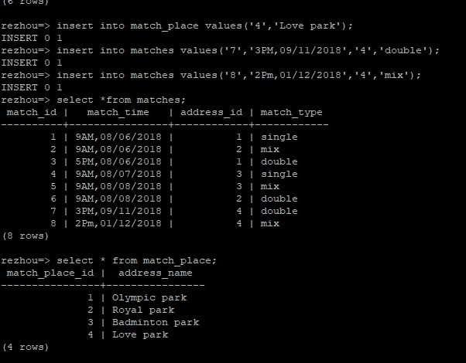
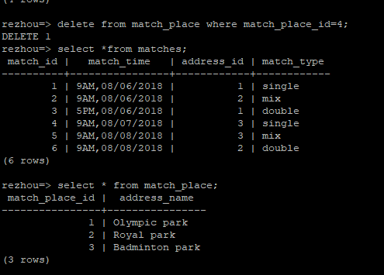
Actions
FOREIGN KEY (address_id) REFERENCES match_place(match_place_id) ON UPDATE CASCADE ON DELETE CASCADE, // when the table match has any changes, the match_place also change.
The output:

Slide 14
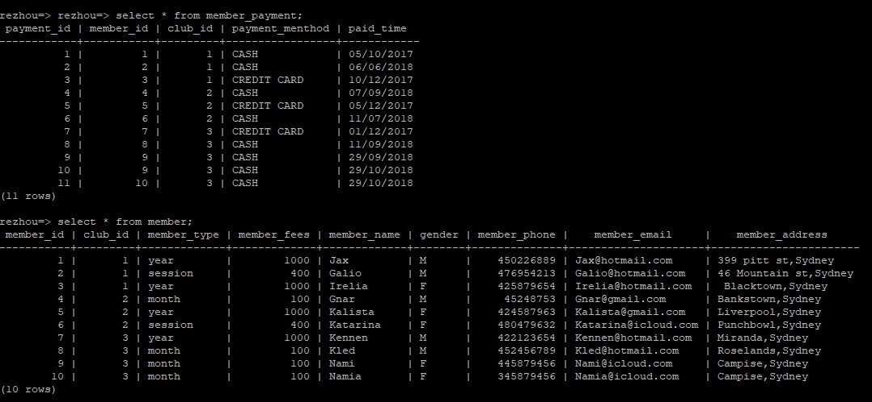
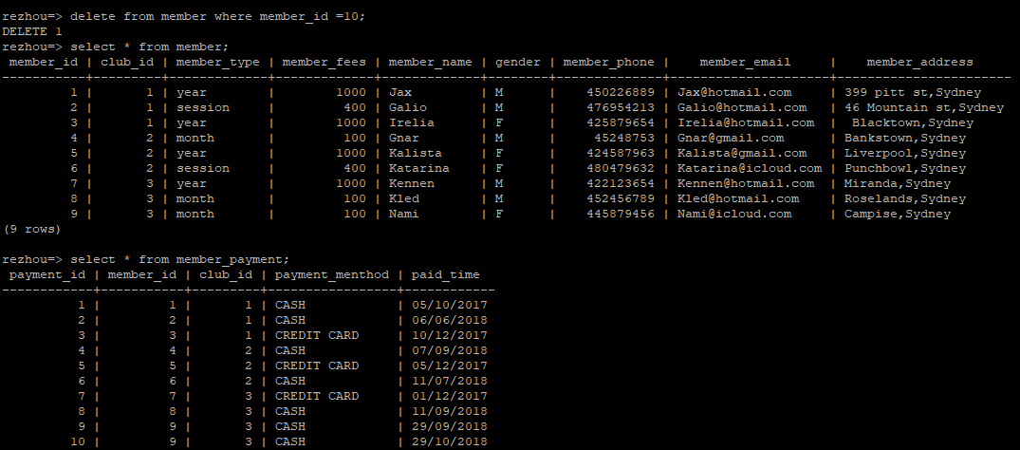
ON DELETE CASCADE
//this query will update any changes happened in member to member_payment. Here is example
The actual query
FOREIGN KEY (member_id,club_id) REFERENCES member (member_id,club_id) ON UPDATE CASCADE ON DELETE CASCADE,
Before delete
After delete

Slide 15
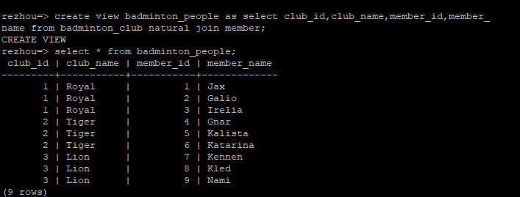
User of view
In this program, the database create a view for the user to have a look.
The actual query to create a view;
// It creates a badminton_people view for user which could help to see the club_id, club_name and their member_id and member_name, by creating a view, it is easy to use the view to do the other operation;
create view badminton_people as select club_id,club_name,member_id,member_name from badminton_club natural join member;
Query to use the view that just created
select * from badminton_people;

